Slide 1
Discovering Valuable Data Insights
Using Python analysing and interpreting data in various industry domains.
Topic chosen : Analysing Olympic Games from Athens to Paris Olympia
It has partnered with the Olympic Association to enhance their understanding of historical and current trends in the Olympic Games. If we are part of the Analytics team at OlympiaSports, Analytics and your task is to perform an Exploratory Data Analysis (EDA) on the Olympic Games data from Athens 1896 to Paris 2024. The insights generated from this analysis will help the Olympic Association in achieving the following real-time applications: Enhancing Athlete Training Programs: By understanding historical performance trends, OlympiaSports Analytics will help tailor training programs that focus on improving athlete performance based on age, gender, and event-specific data. Targeted Marketing and Sponsorships: Understanding geographical and demographic trends in medal winnings will enable OlympiaSports Analytics to assist sponsors in targeting the most promising athletes and regions for their marketing campaigns. Promoting Gender Equality in Sports: Insights into gender participation trends will help design initiatives that encourage increased female participation and ensure gender equality in the Olympic Games.

Slide 2
Task Overview: June 2004 Examining Olympic Games: from Athens to Paris Analyze the historic data obtained from the Olympic Games and include the period from 1896 to the year 2024 exploring patterns of annual performances of athletes, events, times marketing strategies, and gender distribution. Closing Remarks as to How the Analysis Was Carried Out
1. Problem Definition - Search performance, the process of sports development and participation. - Assess tech and gender relative changes.
2. Data Preprocessing Load Data: Read the Table into The Pandas Data Frame in Python. Clean Data: After data preparation, addressing issues such as missing values, differing formats and the definition of normalization. Validation: Make sure they do not overlap with each other or if they are, it will be in the correct time frame sections.
3. Exploratory Data Analysis or rather a part of it. Use Python libraries like Pandas, Matplotlib, Seaborn, and NumPy for analysis:
Top 10 Gold-Medal-Winning Countries: Line graph of successful nations over the years.
2.Top 10 Countries in Gymnastics: Gymnastics medal trends by nation line graph.
3. Gender Participation Analysis: A stacked bar chart to monitor the male and female participation in athlete.
4. Sports Count Over Time: Bar graph of the average of total number sports per Olympic year.
5. Age Distribution of Gold Medalists: Bar chart to display the age of peak performance.
6. Summer Sports Over Time: These are represented in the line below in terms of the kind of summer Olympic Sports displayed The chart shows the type of Summer Olympic Sports.
7. Winter Sports Over Time: Organizational chart of Winter Olympic sports development.
8. Average Height Trends: Gender based line graph of the height of athletes over the years.
9. Top Performing Ice Hockey Athletes: Gold, silver and bronze medals for the 5 leading athletes and 5 leading female athletes.

Slide 3
1. Beginner Level: Loading and Exploring Data
Goal: Load an Olympic dataset into a Pandas DataFrame and display basic information (head, columns, shape).
python
Copy code
import pandas as pd
# Load dataset (replace 'your_dataset.csv' with actual dataset link)
df = pd.read_csv('your_dataset.csv')
# Show basic information
print(df.head()) # First 5 rows
print(df.info()) # Summary of columns
print(df.shape) # Dimensions of the dataset
2. Beginner Level: Handle Missing Data
Goal: Clean missing values by filling or dropping them.
python
Copy code
# Fill missing values with the mean (numerical columns) or mode (categorical columns)
df.fillna(df.mean(), inplace=True) # Numerical
df.fillna(df.mode().iloc[0], inplace=True) # Categorical
# Alternatively, drop rows with missing values
df.dropna(inplace=True)
# Verify changes
print(df.isnull().sum())

Slide 4
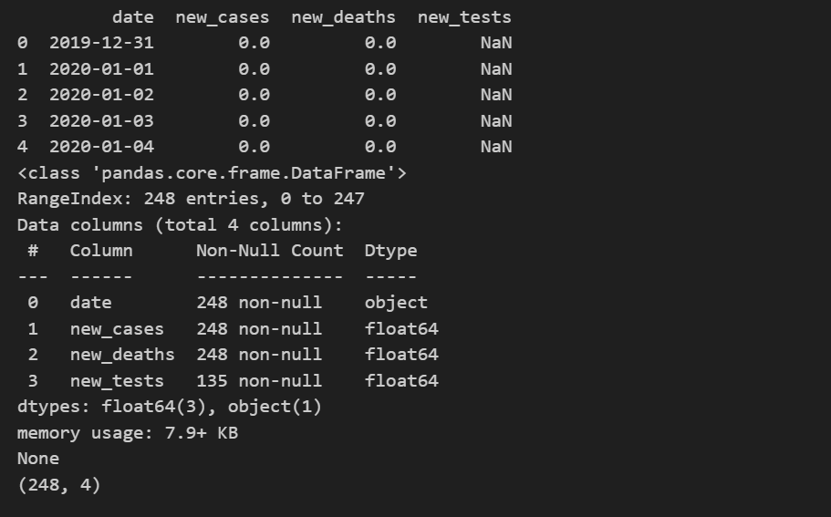
Screenshot of out put

Slide 5
# Fill missing values with mean (numerical columns) or mode (categorical columns)
import pandas as pd
df = pd.read_csv('/olympics2024 (1).csv')
print(df.head())
print(df.info())
print(df.shape)
df.fillna(df.mean(), inplace=True) # Numerical
df.fillna(df.mode().iloc[0], inplace=True) # Categorical
df.dropna(inplace=True)
print(df.isnull().sum())
Rank Country Country Code Gold Silver Bronze Total
0 1 United States US 40 44 42 126
1 2 China CHN 40 27 24 91
2 3 Japan JPN 20 12 13 45
3 4 Australia AUS 18 19 16 53
4 5 France FRA 16 26 22 64
<class 'pandas.core.frame.DataFrame'>
RangeIndex: 91 entries, 0 to 90
Data columns (total 7 columns):
# Column Non-Null Count Dtype
--- ------ -------------- -----
0 Rank 91 non-null int64
1 Country 91 non-null object
2 Country Code 91 non-null object
3 Gold 91 non-null int64
4 Silver 91 non-null int64
5 Bronze 91 non-null int64
6 Total 91 non-null int64
dtypes: int64(5), object(2)
memory usage: 5.1+ KB
None
(91, 7)

Slide 6
3. Beginner Level: Descriptive Statistics
Goal: Generate basic statistical summaries like mean, median, standard deviation.
python
Copy code
# Summary statistics for numerical columns
print(df.describe())
# Gender Distribution
print(df['Gender'].value_counts()) 4. Beginner to Intermediate Level: Gold Medal Visualization based on Countries
Goal: Draw a vertical bar chart of the top 10 countries that need the most gold medals during the period mentioned above. python
Copy code
import matplotlib.pyplot as plt
# Group by country and sum gold medals
gold_medals = df[df['Medal'] == 'Gold'].groupby('Country')['Medal'].count().sort_values(ascending=False).head(10)
# Plot
gold_medals.plot(kind='bar', color='gold')
plt.title('Top 10 Countries with the Most Gold Medals')
plt.ylabel('Number of Gold Medals')
plt.xlabel('Country')
plt.show()

Slide 7
5. Intermediate Level: Gender Participation in the course of time
Goal: Picture the changes in males and females athletes participation. python
Copy code
# Group by year and gender, count the number of athletes
gender_participation = df.groupby(['Year', 'Gender']).size().unstack().fillna(0)
# Plot
gender_participation.plot(kind='line', figsize=(10, 6))
plt.title('Gender Participation Over Time in the Olympic Games')
plt.ylabel('Number of Athletes')
plt.xlabel('Year')
plt.legend(title='Gender', labels=['Male', 'Female'])
plt.show() 6. Intermediate Level: Sports Count Over Time
Goal: Construct a line graph that represents the number of sports that have been available in an Olympic session. python
Copy code
# Group by year and count distinct sports
sports_count = df.groupby('Year')['Sport'].nunique()
# Plot
sports_count.plot(kind='line', figsize=(10, 6), color='blue')
plt.title('Number of Sports in Each Olympic Year')
plt.ylabel('Number of Sports')
plt.xlabel('Year')
plt.show()

Slide 8
7. Intermediate Level: Age of Gold Medalists
Goal: Graph the distribution of the age of those athletes who have won gold medals. python
Copy code
# Filter gold medalists
gold_medalists = df[df['Medal'] == 'Gold']
# Plot age distribution
gold_medalists['Age'].plot(kind='hist', bins=20, color='gold', edgecolor='black', figsize=(10, 6))
plt.title('Age Distribution of Gold Medalists')
plt.xlabel('Age')
plt.ylabel('Frequency')
plt.show()
8. Intermediate Level: The Best Performers in Gymnastics
Goal: What years can you graph the top 10 countries in Gymnastics? python
Copy code
# Filter gymnastics events and group by country and year
gymnastics_data = df[df['Sport'] == 'Gymnastics'].groupby(['Year', 'Country'])['Medal'].count().unstack().fillna(0)
# Get top 10 countries
top_10_gymnastics = gymnastics_data.sum(axis=0).sort_values(ascending=False).head(10)
# Plot
top_10_gymnastics.plot(kind='bar', figsize=(10, 6), color='orange')
plt.title('Top 10 Countries in Gymnastics (Total Medals)')
plt.ylabel('Number of Medals'

Slide 9
9. Intermediate Level: Summer vs Winter Sports Count Over Time
Goal: Create two charts to compare Summer and Winter sports over the years.
python
Copy code
# Filter Summer and Winter sports
summer_sports = df[df['Season'] == 'Summer'].groupby('Year')['Sport'].nunique()
winter_sports = df[df['Season'] == 'Winter'].groupby('Year')['Sport'].nunique()
# Plot
plt.figure(figsize=(12, 6))
plt.subplot(1, 2, 1)
summer_sports.plot(kind='line', color='red', title='Summer Sports Over Time')
plt.ylabel('Number of Summer Sports')
plt.xlabel('Year')
plt.subplot(1, 2, 2)
winter_sports.plot(kind='line', color='blue', title='Winter Sports Over Time')
plt.ylabel('Number of Winter Sports')
plt.xlabel('Year')
plt.tight_layout()
plt.show()

Slide 10
10. Intermediate Level: A quantitative historical analysis of India’s Olympic performance
Goal: Map India’s medal tally for all the Olympic Games. python
Copy code
# Filter India's data
india_performance = df[df['Country'] == 'India'].groupby(['Year', 'Medal']).size().unstack().fillna(0)
# Plot India's medal count over time
india_performance.plot(kind='bar', stacked=True, figsize=(12, 6))
plt.title("India's Olympic Medal Performance (1896-2024)")
plt.ylabel('Medal Count')
plt.xlabel('Year')
plt.show()
https://github.com/jagdishkumarhembrom/data-insight-2.git
Thank you

